Slide 1

S-Cubed!
Successful Sight Singing For Middle School Teachers
Music in the Middle with Mr D

Slide 2

Poll:
Your Current Sight Singing Program
Answer the following questions with a show of hands.

Slide 3
Poll #1:
Have you ever heard your children moan with dread when you said to pull out the sight singing books?

Slide 4
Poll #2:
Have you ever felt like a failure when you teach sight singing?

Slide 5
Poll #3:
Do you enjoy teaching sight singing?

Slide 6

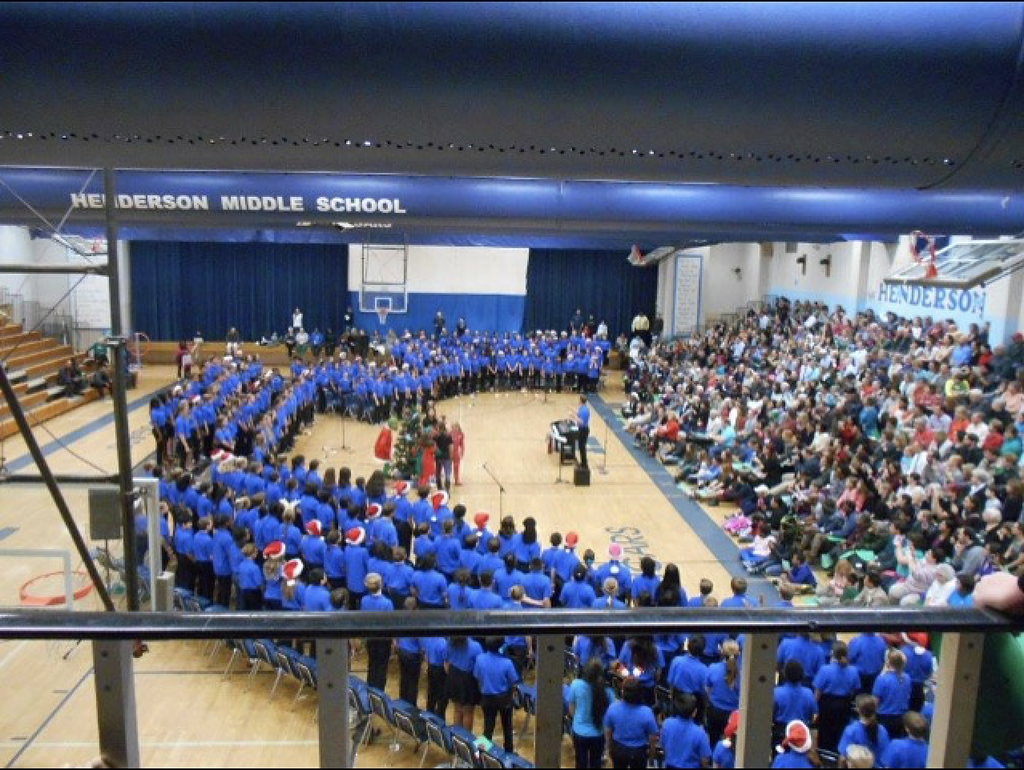
Why I created S-Cubed:
My 300+ students …

Slide 7
Why I created S-Cubed …
I failed so many times!
Other methods skipped too many steps for young singers.
Needed a systematic methodology in an easy to use 21st century format.
Wanted to have FUN while teaching Sight Singing (no moaning!)
Most importantly….
I wanted all 300+ beginners to become musically literate!

Slide 8
My research…
I am not an academic. I was a real teacher in a real Title 1 public school classroom.
My research lab has been 30 years of teaching middle school beginners.
I waited for the “Mozart” child prodigy student to lead the sight singing for the rest, and that person never appeared.
I’ve taken a few courses along the way, taken days off school to watch other teachers, but mostly….
Trial and error!

Slide 9
S-Cubed is a method
AND a
philosophy

Slide 10
This is what we aim for with our beginners…Five minutes to figure it out…
The 8-measure example was just introduced:
How students begin a sight singing example with S-Cubed.
After 5 minutes:
After using all S-Cubed techniques to figure it out a capella

Slide 11
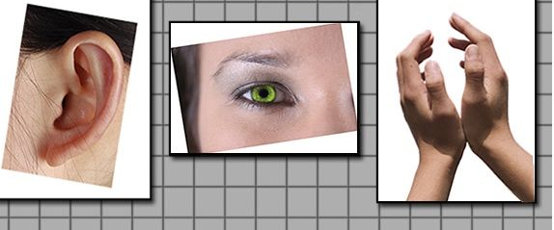


The Three Ingredients
Leverage
All
Learning
Styles
Incorporate
Fun &
Success
Build & Reinforce
10 – 15 minutes/day

Slide 12
Topics for Today
Fun Activities
Singing Positions
Forbidden Pattern
Tools for Your Toolbox
Varied But Comfortable DO
Chaos-How to teach it
Rhythm-Kodaly TA system-Importance of Accents
Learning Styles
Follow the Hand and Ear (Pitch Training)
Training the Eye-Ledger Lines
Pulsing

Slide 13
Interactive: Singing Positions
Instructions: Follow me at your seat!
Position 1: Concert Singing position
Hands by side
Feet shoulder width apart
Chest up/shoulders relaxed
Position 2: Music learning position
Sit at front edge of chair
Torso completely straight
Position 3: Relaxed Position

Slide 14
Interactive: Forbidden Pattern!
Instructions: Follow me at your seat!
Follow my hand signs
Make sure you have a Kodaly Hand Chart in your room.
Introduction of the game.

Slide 15
Tips for the Forbidden Pattern Game
Use these ideas each time you play the game for the next couple of months.
Acknowledge: … good hand placement during the game. Students love to be caught doing the right thing. Others students will emulate them. Later in the method, hand placement will help them find pitches, so it is imperative to create good habits while using the game.
Explore: … how to have fun with the game using your personality. This gets them hooked and excited – students love when the teacher is having fun too!
Observe: … students who have pitch problems and focus issues.
Encourage: … students to use the signs even if they are making mistakes. It is critical that each student use their hands every day. During the first 10 lessons, continue to stay on top of this.
Allow: … students to win the game sometime during the 1st week by going slowly enough that they can score a win. It keeps them excited. Speed up the game as they get better. Keep morale high while they get comfortable with the signs.
Use: ... a key that is comfortable for their voices. I recommend that “DO” is anywhere from Middle C to E for this first game. Vary slightly in each subsequent game so they don’t learn “fixed” DO. Keep a comfortable range. In month 4 or 5, begin to vary the keys – a “Varied, but comfortable DO”.

Slide 16
Teaching Forbidden Pattern
Teaching Tips for Playing Forbidden Pattern

Slide 17
Using Distractions….
Some fun for the teacher!
While it is important to keep the game fast paced, add an element of fun by “distracting” the students from the forbidden pattern.
The first time you use “distractions”, tell the students what you are doing; introducing a distraction because you like to win, and want to make them forget what the forbidden pattern of the day.
For example, you can make it obvious by briefly stopping the game and talking about something random in hopes of helping them forget the forbidden pattern so you can win!
Other times, you can briefly stop the game in order to teach or reinforce a point:
Voices (terminology, vocal production, etc.)
Vowel Production
Correcting Hand Signals and Posture
Refer to something you will teach today in a song.
The key is to keep the distraction brief so they stay focused and keep the game interesting.
Make sure they maintain their singing posture while you distract.

Slide 18
Some Tools for your Toolbox

Slide 19
New Tool:
Training the Ear

Slide 20
Moving Toward PITCH
Follow the Hand
Using FOLLOW THE HAND to develop the ear and the ability to connect the HAND to the PITCH
Using the bullseye
Drawing on a staff and pointing without regard for rhythm

Slide 21
Video of Follow the Hand
Video of Ear Training Exercise

Slide 22
Sight Singing Example #1 Lesson 4

Slide 23
Example: Solfege Ladder for the classroom

Slide 24
Example: A Bullseye for your classroom

Slide 25
New Tool:
Training the Eye

Slide 26
Written/Oral Warm Up Day 1 Lesson 5 Activity #1:
Review of Line and Space Notes on the Staff

Slide 27
Sight Singing Example #2

Slide 28
Sight Singing Exercise
Day 2 Lesson 5

Slide 29
New Tool:
Varied But Comfortable DO
What is it?
Why do I use it?
When do I stop using it?

Slide 30
New Tool: CHAOS
What is it?
Why do I use it?
Pitfalls: Singing yourself in on the correct starting pitch.
When do I stop using it?

Slide 31
This is a video of my 6th graders learning CHAOS.
At the 3 min 46 second mark, they used CHAOS! for the first time. I had just taught the principles of it.
Click the link!
Video of First Day of Chaos with 6th graders

Slide 32
CHAOS – What Is It?
Well, if you teach middle school, you already know about Chaos! ☺
”Chaos” is highly structured (believe it or not) independent practice time that occurs once a Sight Singing example has been introduced and discussed.
Once the “Chaos” period is over, you can discuss the example in more detail if necessary in order to guide them before they sing as a class. You could also give them a second period of “Chaos” before they sing the example as a group after the discussion.
However, if the piece is quite simple, you can simply count them in after one round of “Chaos” and allow them to sing the example. Right now, the examples are simple. Later, we will take time to discuss specific survival strategies for the students to use.

Slide 33
CHAOS – The Rules
Sing independently.
Everyone must sing, and you should sing at a normal volume at your own speed or pace.
Use Hand Signs.
Ignore everyone around you. Create your own Bubble World.
Keep singing until I tell you to stop (usually about one minute). You must sing the entire time even if you sing it perfect the first time. If you finish early, then go back and sing it again.
You aren’t allowed to sing with others or work together in any way.
If you encounter a difficult spot, go back and practice that spot until time is called.
The teacher will simply watch you work. This is one of the ways you will receive your daily grade.

Slide 34
New Tool:
Accents
and
Meter

Slide 35
ACCENTS and METER
Rhythm is easy by itself – use the rhythm exercises to establish solid accenting technique.
Revving of the voice
Taking the time to TEACH and PRACTICE counting in varied time signatures.
Counting yourself in.
Singing yourself in.

Slide 36
Video of me beginning to teach meter

Slide 37
Written Warm Up:
Follow accent rules learned in Lesson 7

Slide 38
Group Rhythm Exercise

Slide 39
Sight Singing

Slide 40
SIGHT SINGING

Slide 41

QR Code to get access to this file with links
Use your camera to get the code
Share it with yourself via email by copying the link so the video links will work on a laptop.

Slide 42

ASSESSMENT
Sight Reading Factory
Do you use Sight Reading Factory subscriptions for you and/or your students?
Use Promo Code “Scubed” to get a 10% discount!

Slide 43


ASSESSMENT
Exciting partnership with
MusicFirst and Smart Music
Homework examples that supplement S-Cubed and also offers lots of practice!

Slide 44
S-Cubed Giveaway for YOU
Someone in this room is going to win the S-Cubed Sight Singing MEGA Bundle!
Enter on my blog right now.
Use your phones to go to- inthemiddlewithmrd1.blogspot.com
I will give more instructions verbally so listen up!
Everyone who enters will receive an email from me letting you know who the winner is. I will also share with you how to get the most popular S-Cubed Bundles for 50% off all day from Friday through Monday night at midnight (in case you want to use a purchase order on Monday at school.).

Slide 45
Soon…My students began to LIKE Sight Singing!
I think the reason is…
They feel successful with each methodical step.
Success is celebrated.
We make FUN a big part of our everyday Sight Singing experience.

Slide 46
How long will this take?
… About 10-15 minutes per day, for 6-7 months.
By then, your beginners will be able to Sight Sing 2-part exercises with very few, if any, errors.
….and best of all, they have a great time during the process.

Slide 47


What is the delivery method?
Visit: In The Middle With Mr. D
I offer the Lessons on my Teacher Pay Teachers website. There are about 30 lessons that will help you achieve the 2-part goal with your beginners.
I am using YouTube. Teachers can view the videos and see and hear how I deliver the method. They can also have their students watch the videos as they may find it helpful to see other students working on the same material. I am uploading the videos onto YouTube as I teach them to one of my beginning 6th grade classes. It is like a reality show of sorts! You can see them progress. You can see how we deal with the difficult moments in the program.

Slide 48
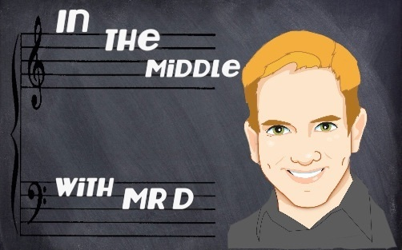
What do you receive in each lesson?
Actual Sight Singing Examples to use in each lesson.
Actual warm up lessons (written and/or oral).
Actual rhythm exercises.
Game descriptions.
Teaching sequences.
Video Teaching tips and techniques.
YouTube videos of me teaching parts of the lessons to real students.

Slide 49
Some S-Cubed Video Links
http://youtu.be/JoO6R4OHSIY
Click above link for a description of the Game ”Forbidden Pattern”
http://youtu.be/TlUd8v-BONs
Click above link for a video of Mr D teaching Forbidden Pattern to beginners.
http://youtu.be/94rxOLxqksE
Click the above link for a sample Ear Training exercise.
http://youtu.be/u60Y3sWGe9E
Click the above link to see a sample of ”Follow the Hand” used with real beginners.
http://youtu.be/-fgekti7Dqc
http://youtu.be/LcbQcdV-Mp0
Click either of the links to see how carefully to “Train the Eye” of the beginner.
http://youtu.be/nLNwln_cp8k
Click the above link to see ”Chaos” taught on the first day with beginners.
http://youtu.be/Msev4peMGZs
Click the above link to see teaching of ACCENTS/METER

Slide 50
Stay connected with Mr. D!
Subscribe to my email list- Send me an email at inthemiddlewithmrd@gmail.com and write the word SUBSCRIBE in the subject line.
•Follow my blog where I share lots of teaching ideas and random thoughts about my teaching experience in the middle school choral classroom! My blog!
•Follow me on Twitter!
•Follow me on Facebook!
•Follow my TpT store!
•Click here to subscribe to my YouTube Channel! You’ll find lots of sight singing teaching tips as well as teaching examples of all sorts about various subjects related to teaching in the middle school choral classroom!
•Follow me on Instagram!
•Join the Facebook Group I Teach Middle School Chorus!

Slide 51
Questions?
Thank you very much
for your attention today!

